Slide 1
Investigate Data Leakage Case
Keywords: Volume Shadow Copy, anti-forensics
Notes:
http://xmlstar.sourceforge.net/doc/UG/

Slide 2
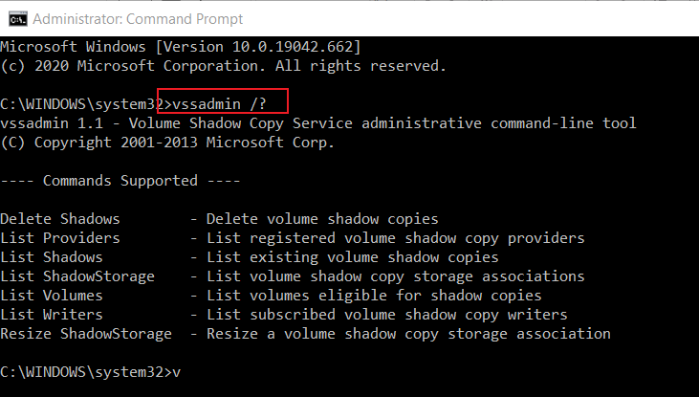
47. Where are Volume Shadow Copies stored? When were they created?
Volume Snapshots Service (VSS)
A feature of Windows
Allows the OS or applications to periodically take "point-in-time snapshots" of an entire disk
Work without locking the filesystem
Introduced with Windows XP/2003
Notes:
https://docs.microsoft.com/en-us/windows/win32/vss/volume-shadow-copy-service-overview

Slide 3

Volume Shadow Copy (VSC)
Volume Shadow Copy Service
Are "differential, block-level backups“
Whenever a change is made to live data, the block of data being modified is copied to a “differences area” associated with the shadow copy before the change is written to the live data block.
Fast and easy to recover directly from Windows.
Shadow Copy has different IDs
VSC ID, shadow snapshot ID, shadow Copy setID, and shadow Copy ID
VSC is useful feature of forensic analysis
C:
D:
E:
Snapshot 1
C’:
D’:
E’:
shadow Copy setID
Snapshot 2
C’’:
D’’:
E’’:
shadow Copy ID
Notes:
https://helpcenter.itopia.com/en/articles/724296-configuring-volume-shadow-copies-vss-on-windows-server
https://leahycenterblog.champlain.edu/2014/02/05/volume-shadow-copy-part-2/

Slide 4
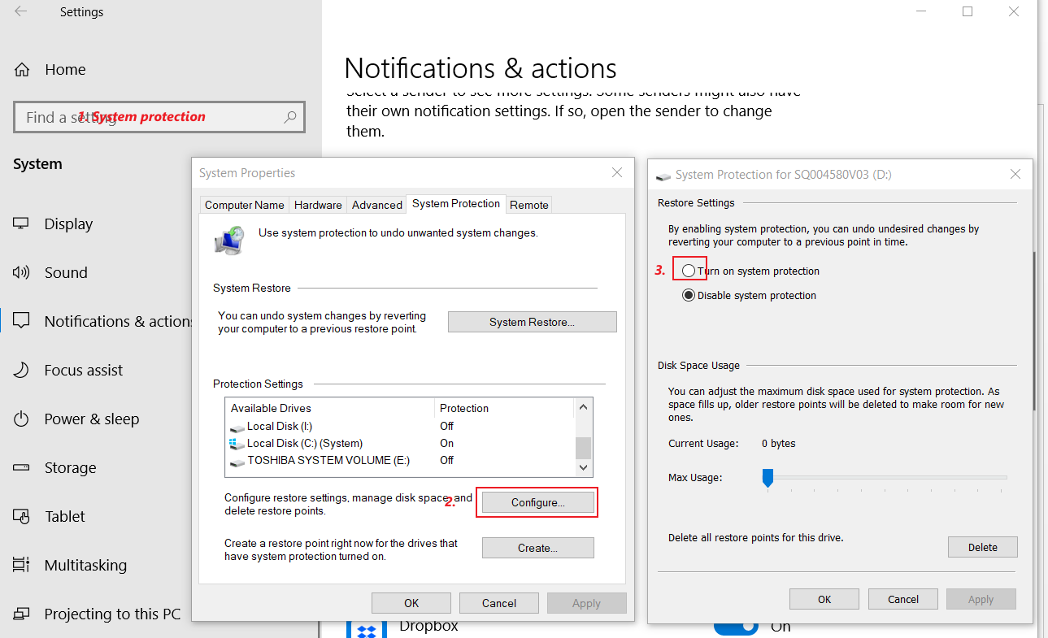
enable the shadow copy option

Slide 5
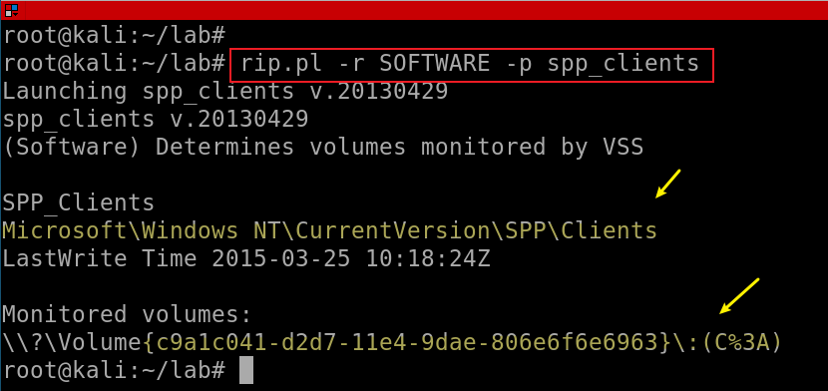
Find the monitored Volumes
Find monitored Volumes in registry
Shared protection point
%3A: ASCII Encoding of :
Notes:
rip.pl -r SOFTWARE -p spp_clients

Slide 6
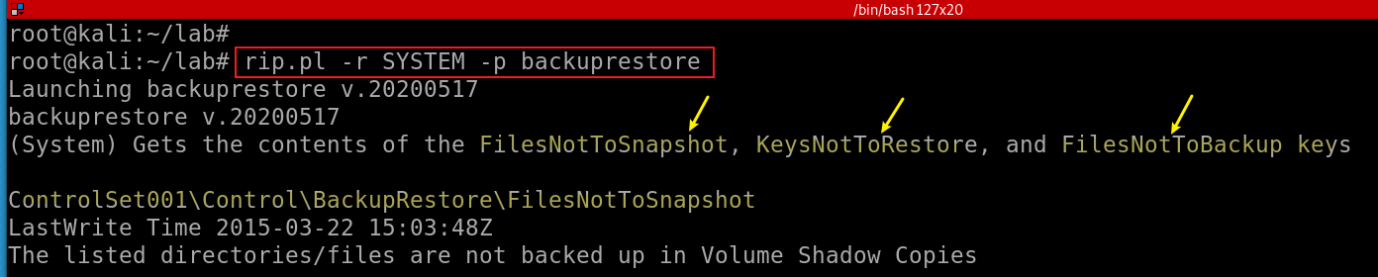
Excluding Files from Shadow Copies
Find Excluding Files from Shadow Copies in registry
Doesn’t snapshot: Unallocated space, Slack space , Page file, Hibernation file
Exclude: FilesNotToSnapshot, KeysNotToRestore, and FilesNotToBackup
Notes:
rip.pl -r SYSTEM -p backuprestore

Slide 7
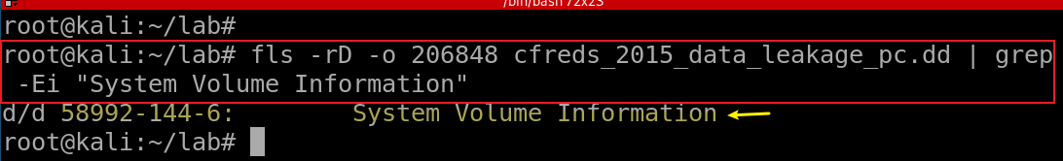
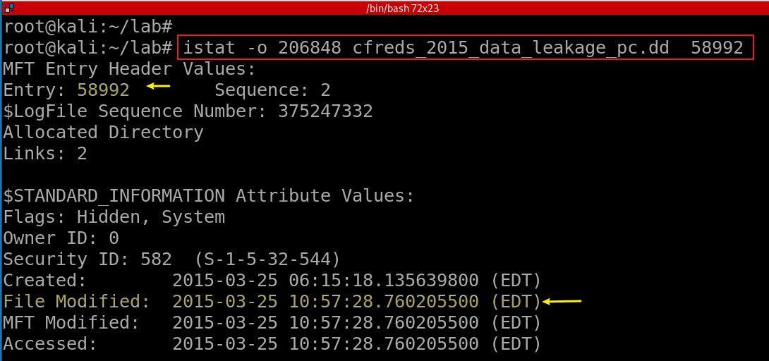
Find VSS location
Find $MFT entry ID
Find MAC timestamp of the folder
Notes:
fls -rD -o 206848 cfreds_2015_data_leakage_pc.dd | grep -Ei "System Volume Information"
istat -o 206848 cfreds_2015_data_leakage_pc.dd 58992

Slide 8
Volume Shadow Snapshots (VSS) on-disk
 | Header (VSS ID) 3808 |  | Catalog Contains store info Radom Store GUID Timestamp Location of store |  | Stores Contains one snapshot Shadow copy set ID Shadow copy ID

Slide 9
Shadow Copy location
\System Volume Information\{Store GUID}{VSS ID}
VSS ID stored at file offset 0 for 16 bytes
{3808876b-c176-4e48-b7ae-04046e6cc752}
VSC ID stored at file offset 144 for 16 bytes
{8f1a2a2d-ce6b-42a5-b92b-f13e65d9c2cb}
VSC set ID stored at file offset 160 for 16 bytes
{56e43eb5-ac18-4f06-a521-1e17712b7ced}
Old shadow copies are overwritten
Shared protection point (SPP)
The location of monitored volume

Slide 10
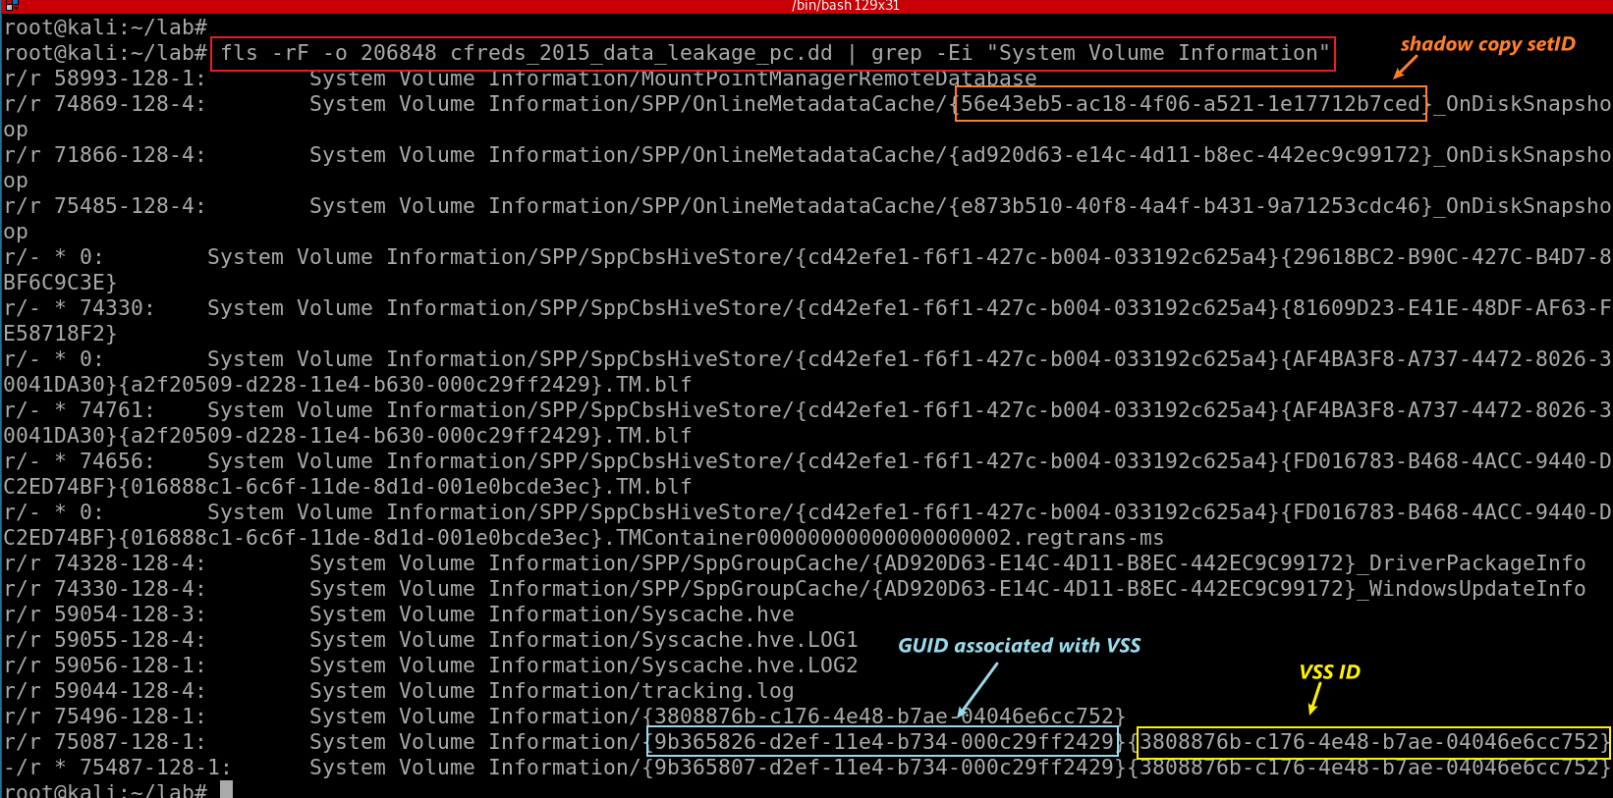
Find all files contains the path “System Volume Information”
Notes:
losetup -r --partscan --find --show cfreds_2015_data_leakage_pc.dd
fls -rF -o 206848 cfreds_2015_data_leakage_pc.dd | grep -Ei "System Volume Information"

Slide 11
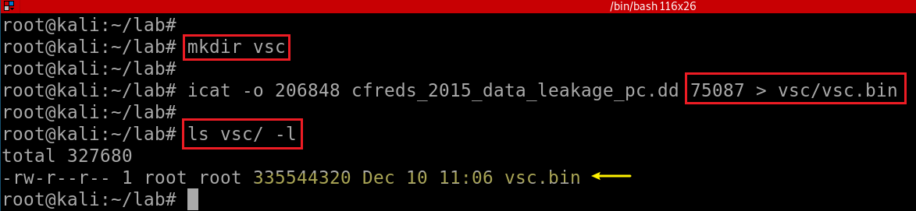
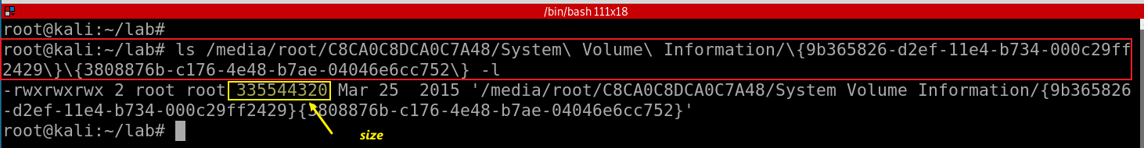
Find the size of VSC method 1 using icat
Find the size of VSC method 2 after mounting
Notes:
mkdir vsc
icat -o 206848 cfreds_2015_data_leakage_pc.dd 75087 > vsc/vsc.bin
ls vsc/ -l

Slide 12
Using libvshadow tool to retrieve Snapshot from a DD image
libvshadow is a library to access the Volume Shadow Snapshot format.
The snapshot format is used by Windows, as of Vista, to maintain copies of data on a storage media volume.
Notes:
https://www.youtube.com/watch?v=OtIk2ldtWno&ab_channel=0xN00B

Slide 13
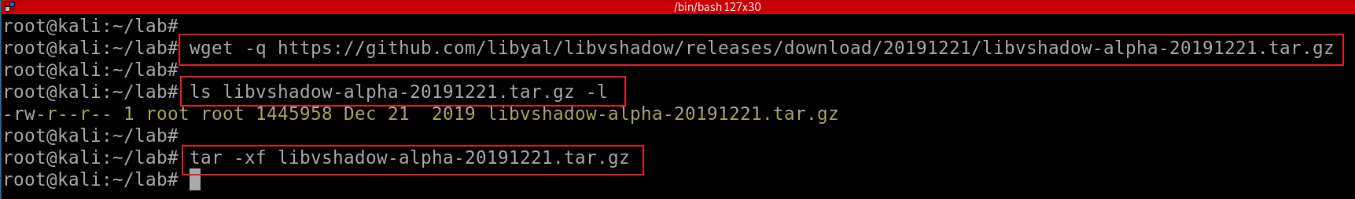
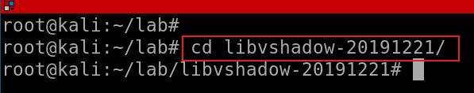
Install libvshadow
retrieve the source distribution package
extract the source distribution package
This will create the source directory: libvshadow-<version>
Change to source directory
Notes:
wget -q https://github.com/libyal/libvshadow/releases/download/20191221/libvshadow-alpha-20191221.tar.gz
ls libvshadow-alpha-20191221.tar.gz –l
tar -xf libvshadow-alpha-20191221.tar.gz
python setup.py build
sudo python setup.py install

Slide 14
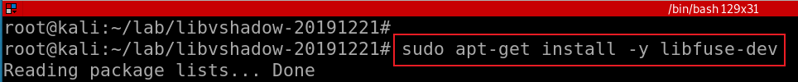
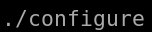
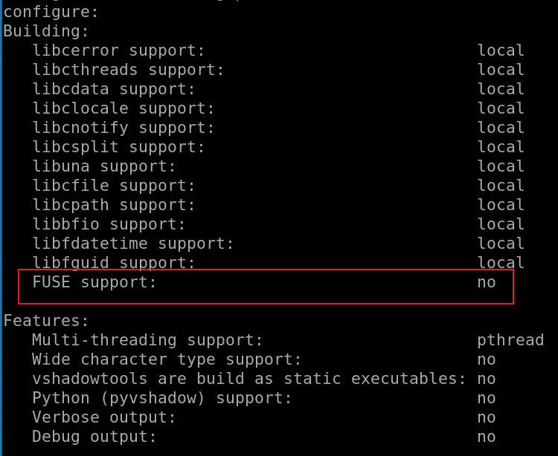
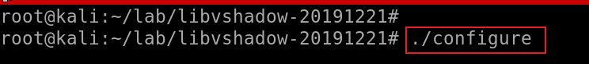
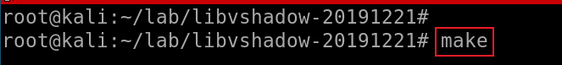
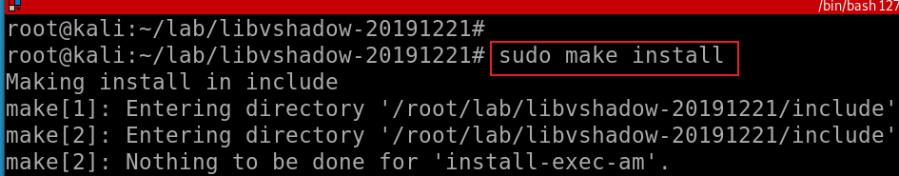
FUSE (Filesystem in Userspace) is an interface for userspace programs to export a filesystem to the Linux kernel. Without it, you will see error message ”No sub system to mount VSS format”
Install FUSE
Build the libvshadow source code change into the source directory
Install the binaries that were build by running:
Notes:
sudo apt-get install -y libfuse-dev

Slide 15
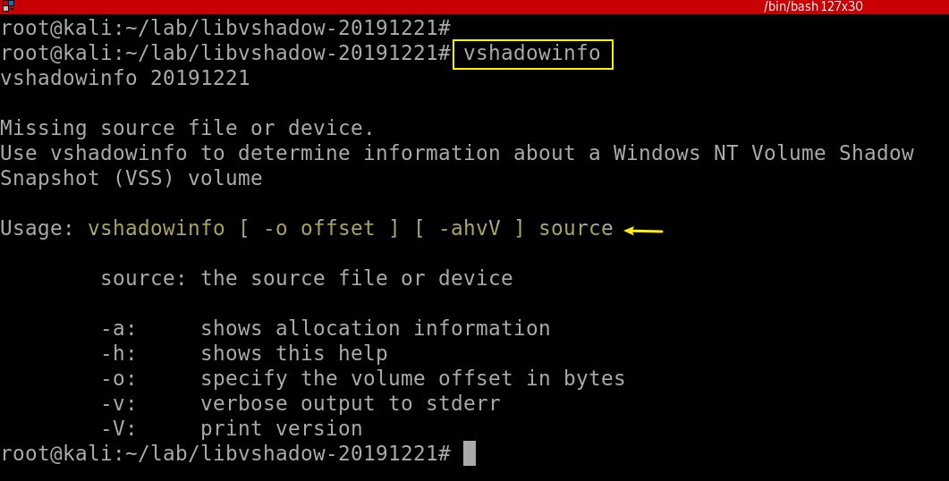
Verify tool installation
In bytes not sectors

Slide 16
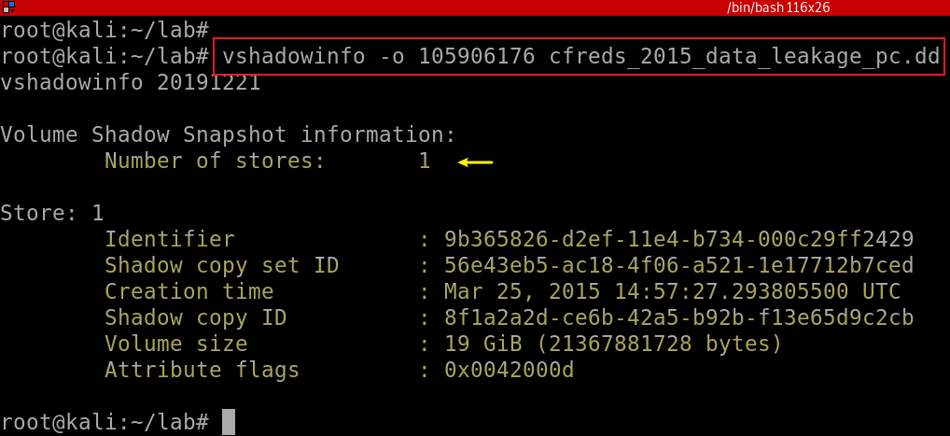
Find VSS information using vshadowinfo
206848*512(bytes per sector)=105906176 bytes
Identifier: A random GUID for storing a snapshot
Notes:
vshadowinfo -o 105906176 cfreds_2015_data_leakage_pc.dd

Slide 17
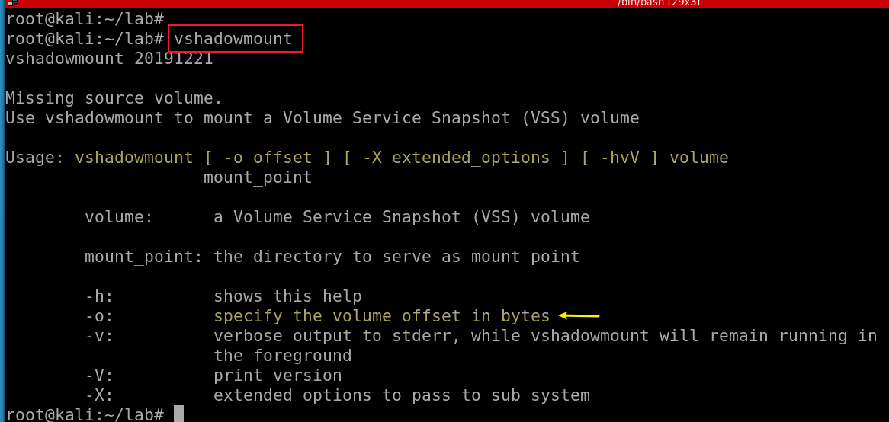
The name of the command is confusing. It extract vss image, not real mounting
Verify tool installation

Slide 18
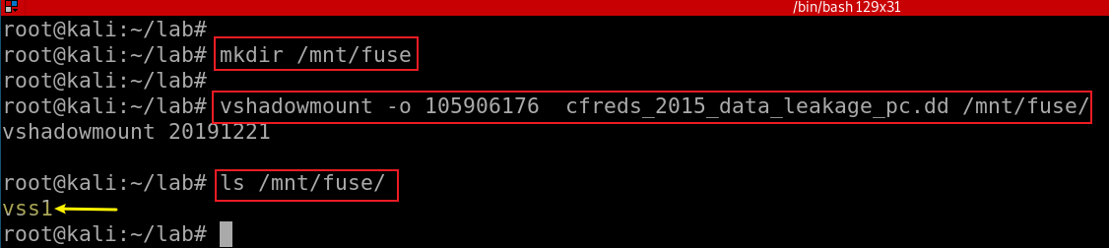
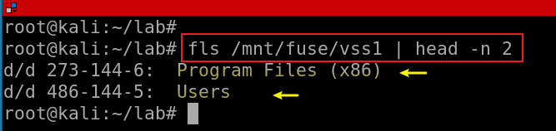
Create a mounting point to VSS
Mount dd image to the mounting point
Verify we have VSS1 image
VSS volume: /mnt/fuse/vss1
Show vss1 image
Notes:
mkdir /mnt/fuse
vshadowmount -o 105906176 cfreds_2015_data_leakage_pc.dd /mnt/fuse/
ls /mnt/fuse/
fls /mnt/fuse/vss1 | head -n 2
https://www.youtube.com/watch?v=OtIk2ldtWno&ab_channel=0xN00B

Slide 19
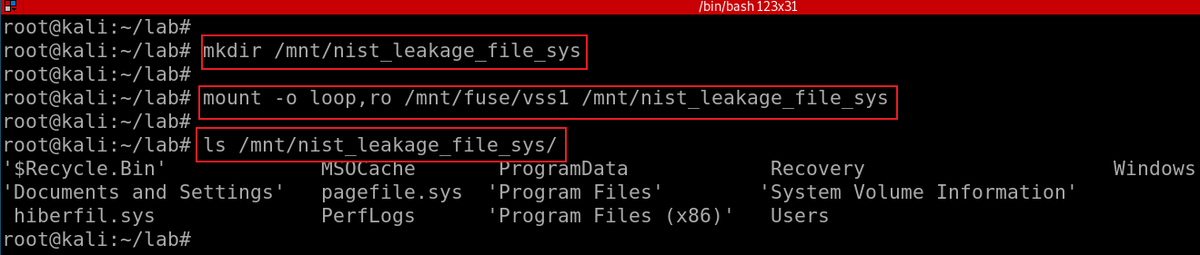
mount the VSS1 file as a loop device
Notes:
mkdir /mnt/nist_leakage_file_sys
mount -o loop,ro /mnt/fuse/vss1 /mnt/nist_leakage_file_sys
ls /mnt/nist_leakage_file_sys/
https://www.youtube.com/watch?v=OtIk2ldtWno&ab_channel=0xN00B

Slide 20
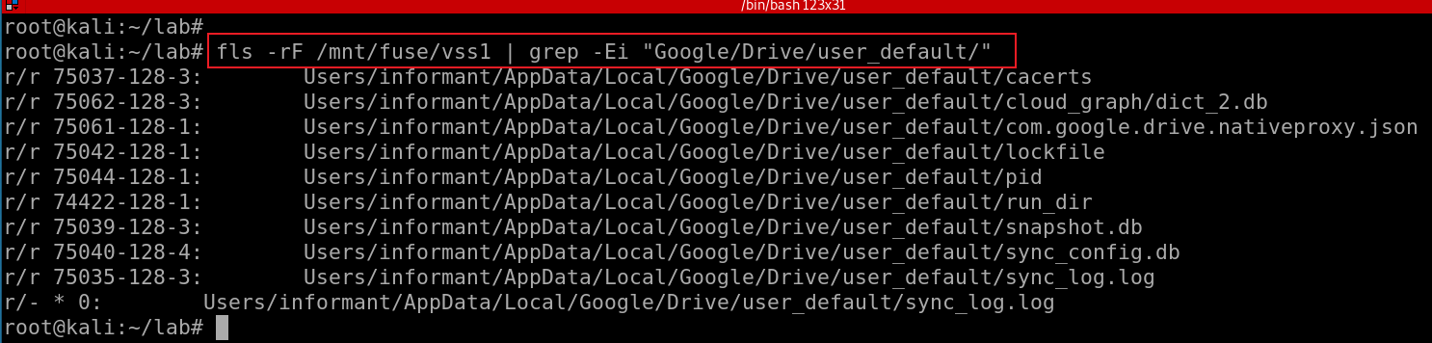
48. Find traces related to Google Drive service in Volume Shadow Copy.
What are the differences between the current system image (of Question 29 ~ 31) and its VSC?
Notes:
fls -rF /mnt/fuse/vss1 | grep -Ei "Google/Drive/user_default/"

Slide 21
Files associated with Google Driver
snapshot.db: contains information about local and cloud entries
Cloud_entry table
local_entry table:
sync_config.db: contains profile configuration
has only one table with containing several records including
the Google Drive version used,
the local sync root path and
the user email address.

Slide 22
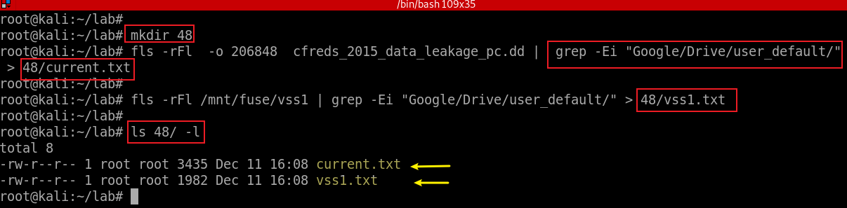
Extract Google drive service files from both DD and VSS images
Notes:
mkdir 48
fls -rFl -o 206848 cfreds_2015_data_leakage_pc.dd | grep -Ei "Google/Drive/user_default/" > 48/current.txt
fls -rFl /mnt/fuse/vss1 | grep -Ei "Google/Drive/user_default/" > 48/vss1.txt
ls 48/ -l

Slide 23
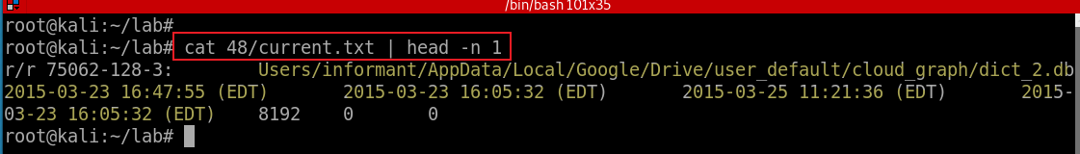
Show first record to understand the file information
file type as reported in file name and metadata structure (see above)
Metadata Address
name
mtime (last modified time)
atime (last accessed time)
ctime (last metadata changed time, e.g., permission)
crtime (created time)
size (in bytes)
uid (User ID)
gid (Group ID)
Notes:
https://wiki.sleuthkit.org/index.php?title=Fls

Slide 24
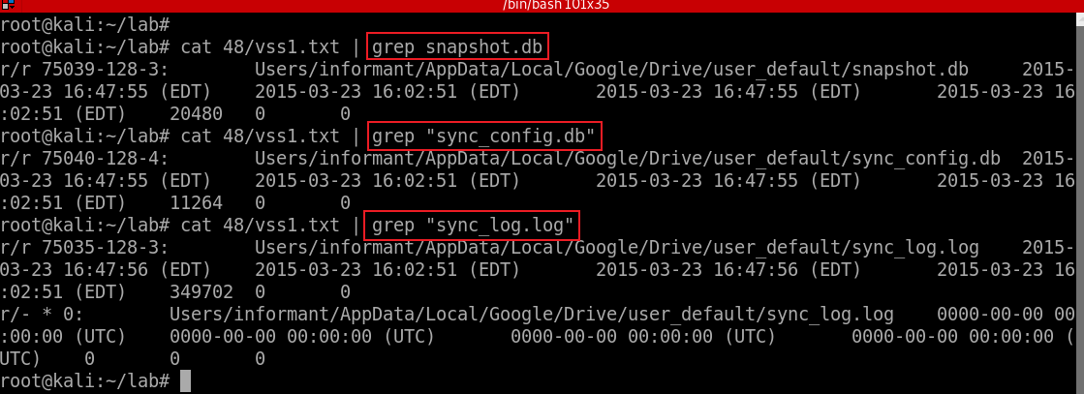
Search Google Driver service files (databases) related files in VSS1
Notes:
cat 48/vss1.txt | grep snapshot.db
cat 48/vss1.txt | grep "sync_config.db“
cat 48/vss1.txt | grep "sync_log.log"

Slide 25
49. What files were deleted from Google Drive?
When files are deleted
Entries of cloud_entry table are deleted
Goal
To find deleted records of cloud_entry table inside snapshot.db from VSC
Just examine the SQLite database only
Let us suppose that a text based log file was wiped.

Slide 26
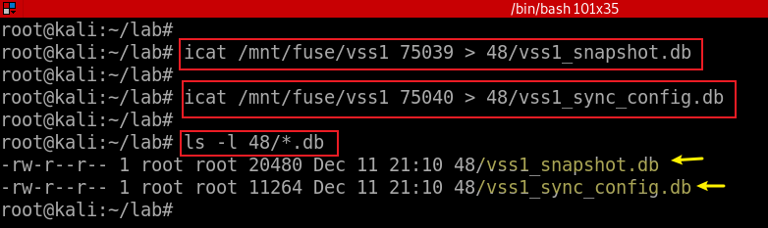
Extract Google Driver service .db files
Notes:
icat /mnt/fuse/vss1 75039 > 48/vss1_snapshot.db
icat /mnt/fuse/vss1 75040 > 48/vss1_sync_config.db

Slide 27
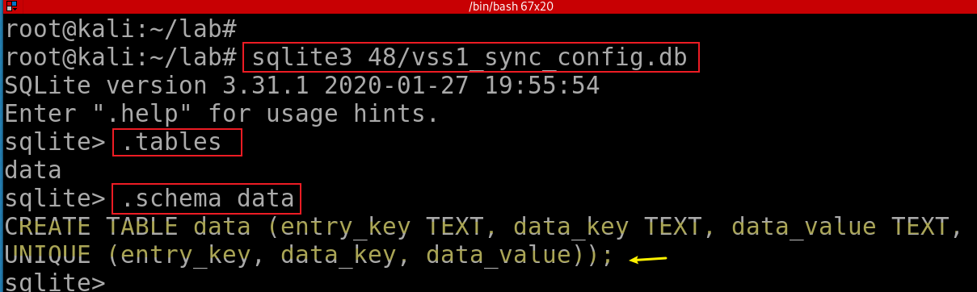
vss1_sync_config.db
It has only one table, including Google Drive configuration information
the Google Drive version used,
the local sync root path and
the user email address.
Show schema vss1_sync_config.db

Slide 28
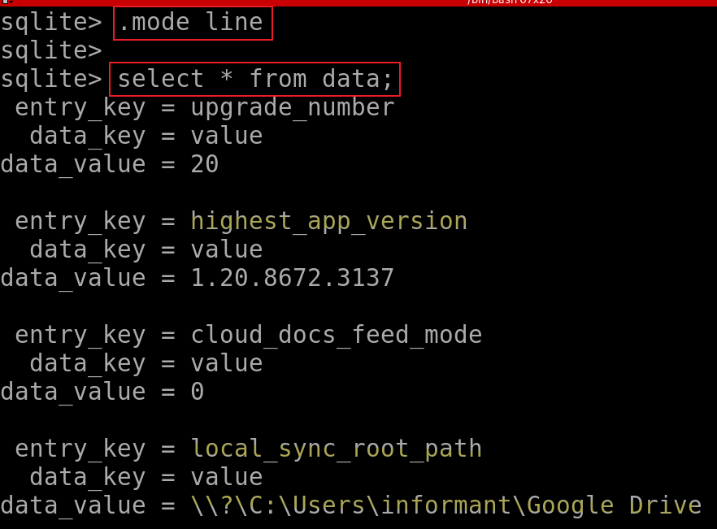
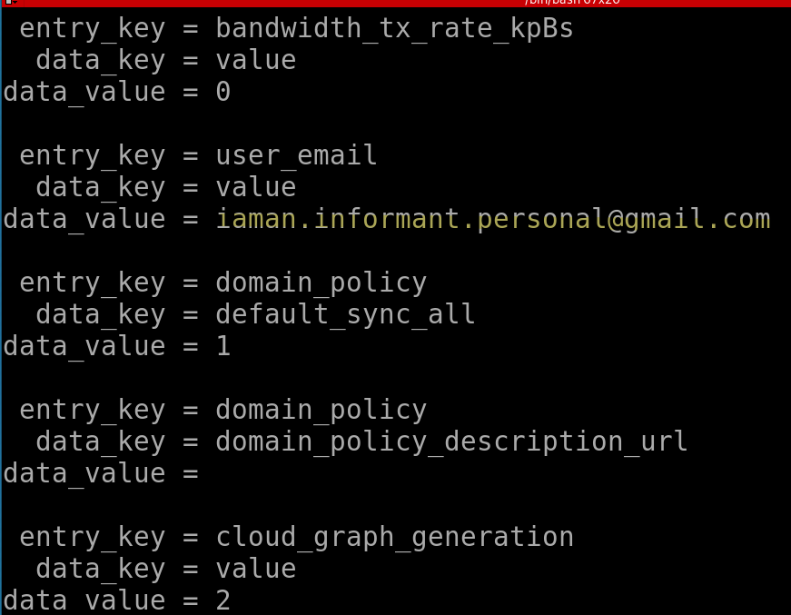
Check records of vss1_sync_config.db
Notes:
.mode line
select * from data;

Slide 29
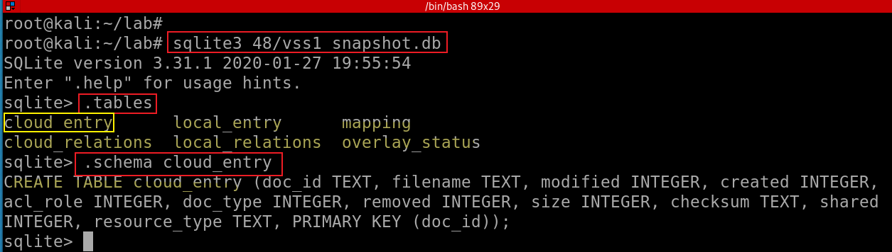
snapshot.db
Show records of snapshot.db
INTEGER. The value is a signed integer, stored in 1, 2, 3, 4, 6, or 8 bytes depending on the magnitude of the value.
TEXT. The value is a text string, stored using the database encoding (UTF-8, UTF-16BE or UTF-16LE).
Notes:
sqlite3 48/vss1_snapshot.db
.tables
.schema cloud_entry

Slide 30
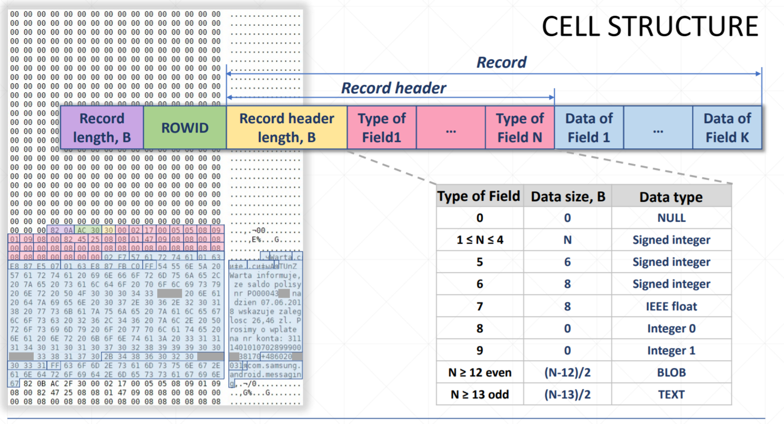

Notes:
https://rusolut.com/wp-content/uploads/2019/05/5_VNR-SQLite-carver.pdf

Slide 31
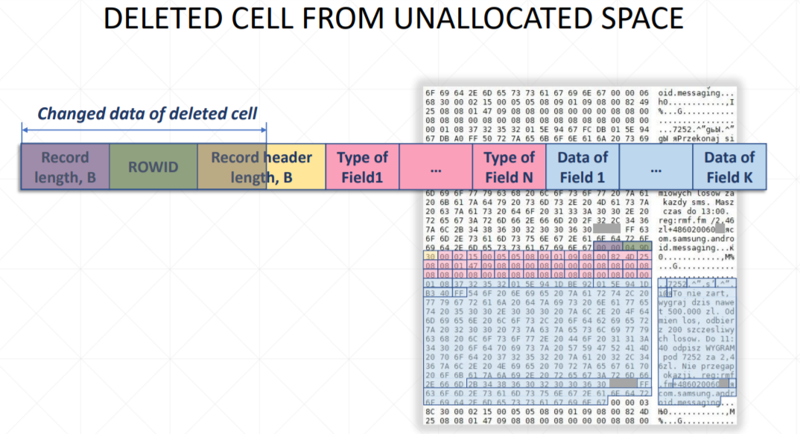

Slide 32
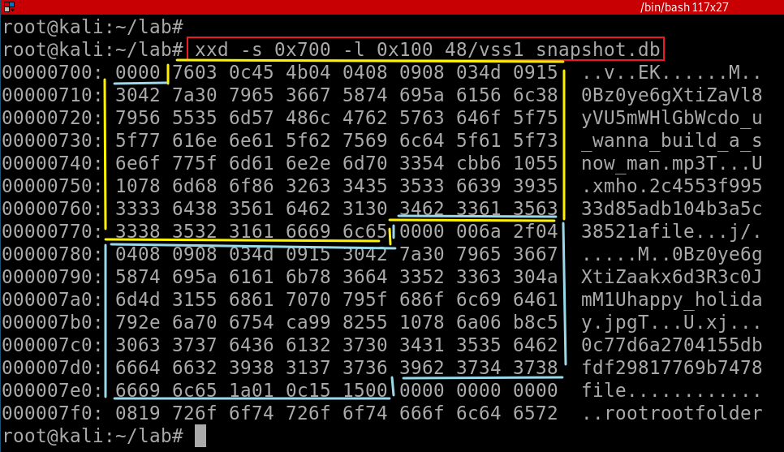
Show two deleted file entries
The first deleted file
do_u_wanna_build_a_snow_man.mp3
The second deleted file
happy_holiday.jpg
Notes:
xxd -s 0x700 -l 0x100 48/vss1_snapshot.db

Slide 33
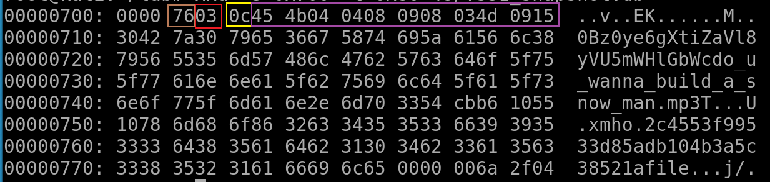
Analyze the first deleted file do_u_wanna_build_a_snow_man.mp3
Record length (0x76) | Row ID (0x03) | Record header length (0x45) | Type of Fields

Slide 34
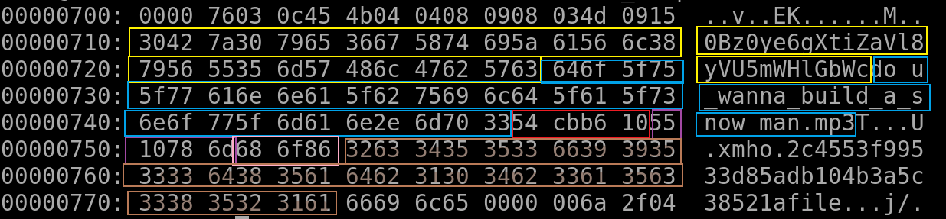
Record Info | Column | Size (bytes) | Data
[File offset 0x702] RecordSize: 0x76 RowID: 0x03 HeaderSize: 0x0C | doc_id | (69-13)/2 = 28 | 0Bz0ye6gXtiZaVl8yVU5mWHlGbWc
 | Filename | (75-13)/2 = 31 | do_u_wanna_build_a_snow_man.mp3
 | modified | 4 | 0x54CBB610 (1422636560) → 2015-01-30 11:49:20 (UTC-05)
 | created | 4 | 0x5510786D (1427142765) → 2015-03-23 16:32:45 (UTC-04)
 | acl_role | 0 | 0
 | doc_type | 0 | 1
 | removed | 0 | 0
 | size | 3 | 0x686F86 (6844294) → 6,844,294 bytes
 | checksum | (77-13)/2 = 32 | 2c4553f99533d85adb104b3a5c38521a
 | shared | 0 | 1
 | resource_type | (21-13)/2 = 4 | file
Notes:
Can we use strings? strings 48/vss1_snapshot.db
More reading https://digitalforensicforest.com/2015/07/27/sqlite-data-carving-a-way-to-trace/
http://forensicsfromthesausagefactory.blogspot.com/2011/04/carving-sqlite-databases-from.html

Slide 35
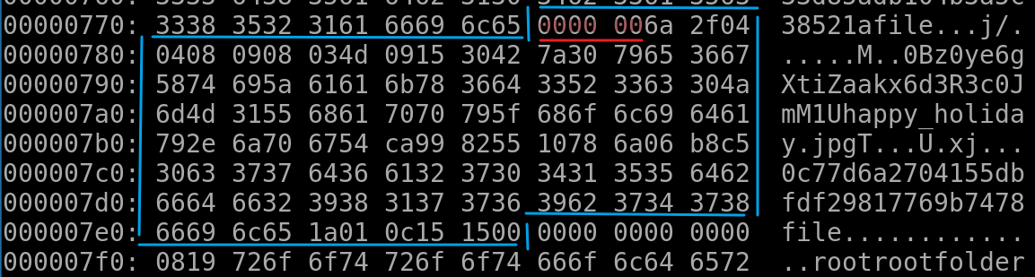
Analyze the second deleted file happy_holiday.jpg
[File offset 0x77A] First 4 bytes are overwritten RecordSize: N/A RowID: N/A HeaderSize: N/A | doc_id | fixed size (28) | 0Bz0ye6gXtiZaakx6d3R3c0JmM1U
 | Filename | (47-13)/2 = 17 | happy_holiday.jpg
 | modified | 4 | 0x54CA9982 (1422563714) → 2015-01-29 15:35:14 (UTC-05)
 | created | 4 | 0x5510786A (1427142762) → 2015-03-23 16:32:42 (UTC-04)
 | acl_role | 0 | 0
 | doc_type | 0 | 1
 | removed | 0 | 0
 | size | 3 | 0x6B8C5 (440517), → 440,517 bytes
 | checksum | (77-13)/2 = 32 | 0c77d6a2704155dbfdf29817769b7478
 | shared | 0 | 1
 | resource_type | (21-13)/2 = 4 | file

Slide 36
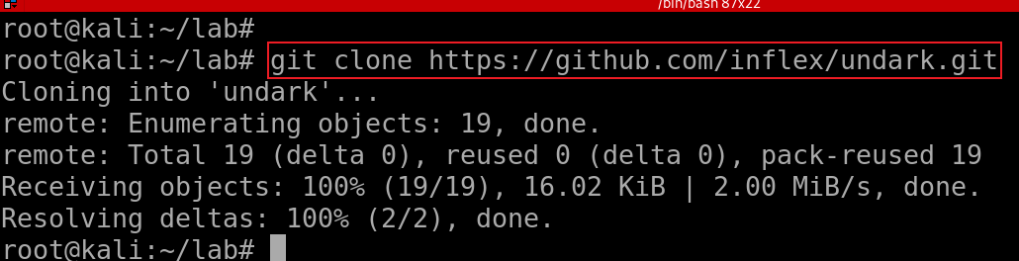
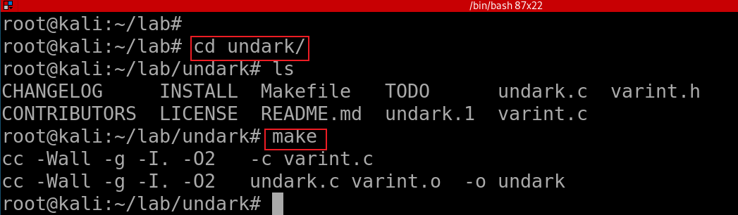
Carving sqlite .db with tools
Clone the project
Build it!

Slide 37
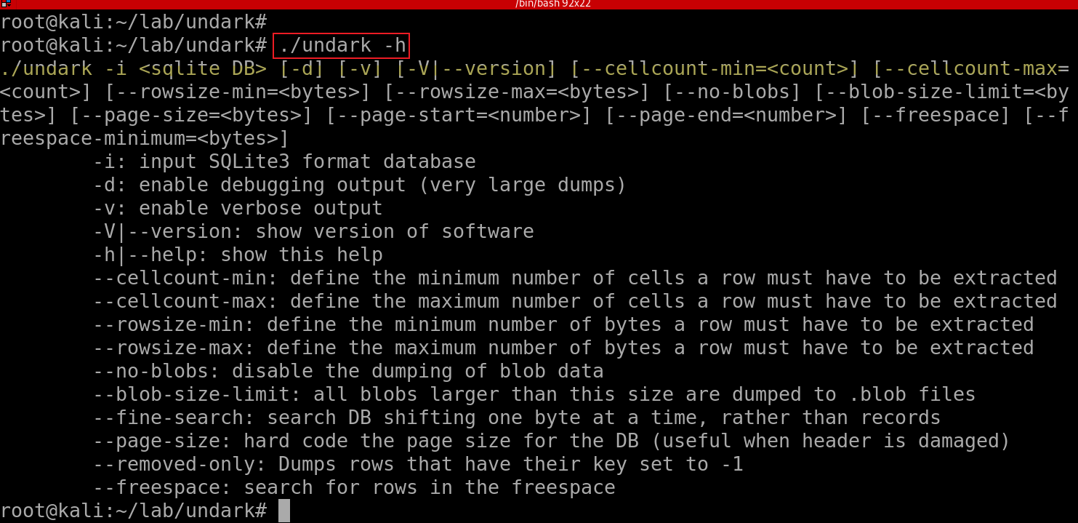
Show Help

Slide 38
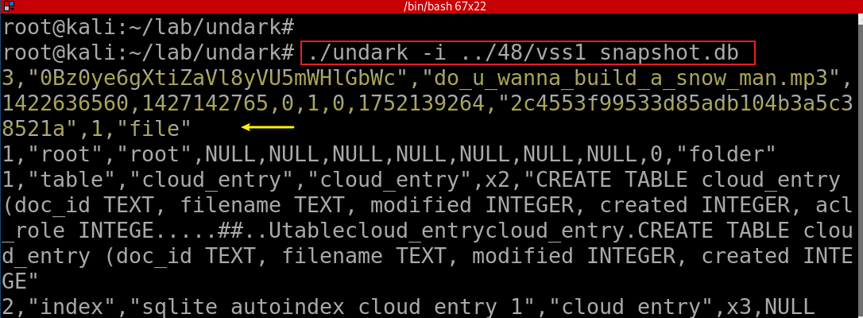
Show Help
Note: the second record can be not carved due to missing information

Slide 39
50. Why can’t we find Outlook’s e-mail data in Volume Shadow Copy?
Find Excluding Files from Shadow Copies in registry
Doesn’t snapshot: Unallocated space, Slack space , Page file, Hibernation file
Exclude: FilesNotToSnapshot, KeysNotToRestore, and FilesNotToBackup
Notes:
https://msdn.microsoft.com/en-us/library/windows/desktop/aa819132(v=vs.85).aspx

Slide 40
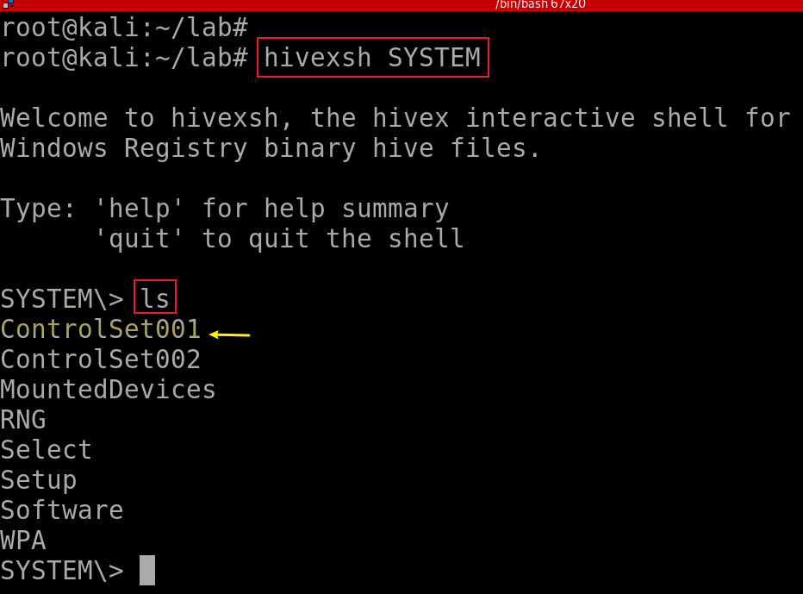
Find System hive
Notes:
hivexsh SYSTEM

Slide 41
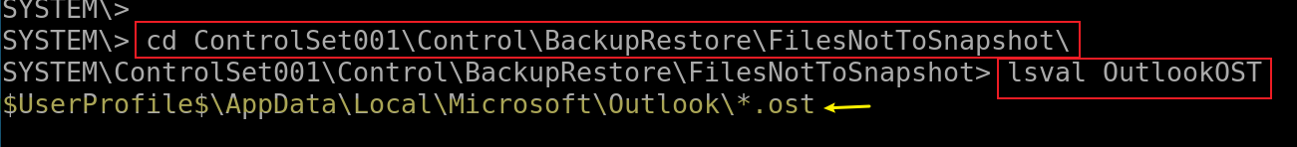
Find HKLM\System\CurrentControlSet\Control\BackupRestore\FilesNotToSnapshot\
lsval [key]: List the (key, value) pairs of the current hive Registry key.
Notes:
cd ControlSet001\Control\BackupRestore\FilesNotToSnapshot\
lsval OutlookOST

Slide 42
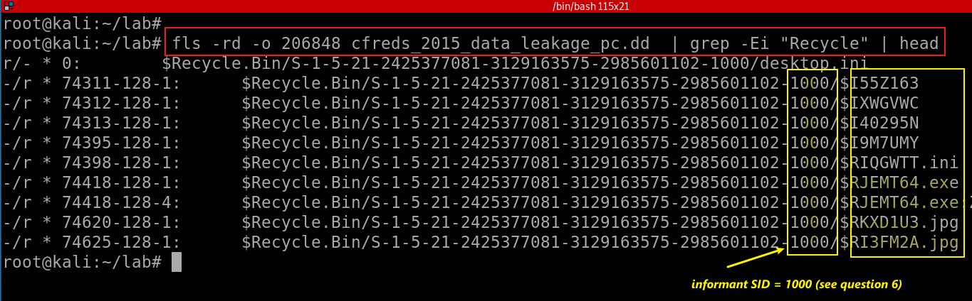
51. Examine ‘Recycle Bin’ data in PC.
Windows 7 Recycle Bin is called $Recyle.bin.
Each deleted file is represented by a pair of files $I[random].extension & $R[random].extension
Notes:
fls -rd -o 206848 cfreds_2015_data_leakage_pc.dd | grep -Ei "Recycle" | head

Slide 43
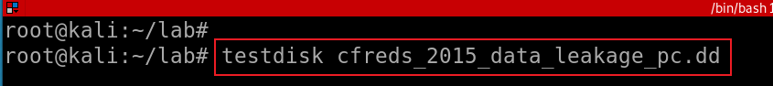
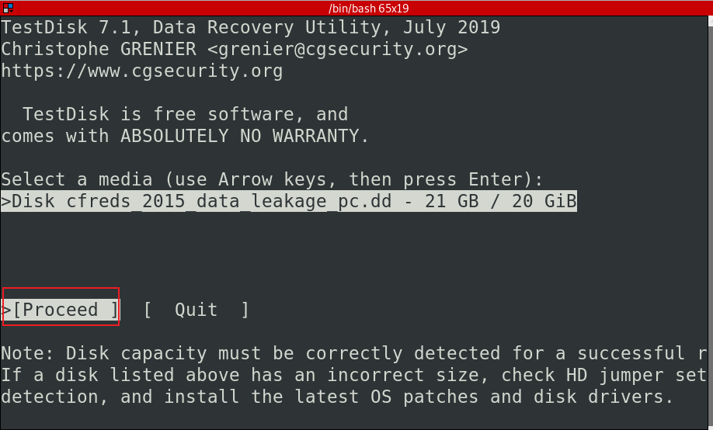
Use testdisk to Recover $Recyle.bin
Recover the image
Recover the image
Notes:
testdisk cfreds_2015_data_leakage_pc.dd

Slide 44
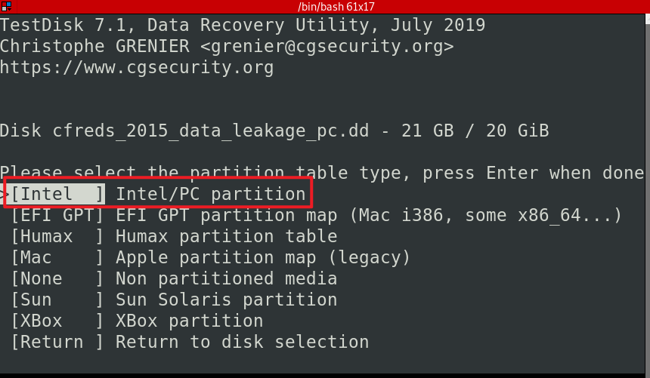
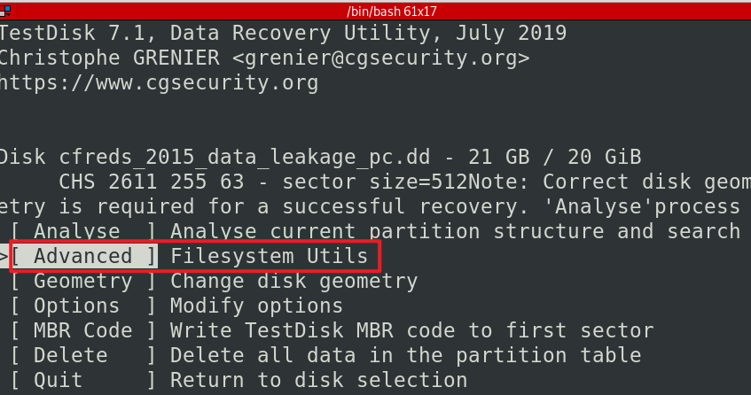

Slide 45
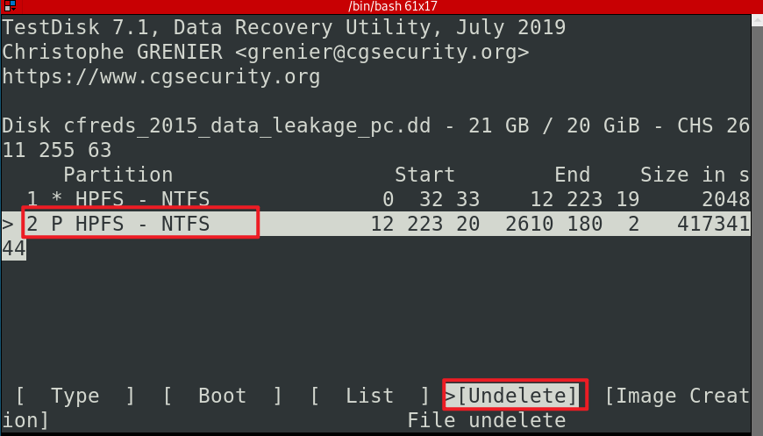

Slide 46

Use RestDisk to recover files
: to select the highlighted files
C: to copy

Slide 47

Choose the destination and copy
Quit all

Slide 48

ls S-1-5-21-2425377081-3129163575-2985601102-1000/ -l

Slide 49

Notes:
strings -el -f S-1-5-21-2425377081-3129163575-2985601102-1000/\$I508CBB.jpg

Slide 50
52. What actions were performed for anti-forensics on PC at the last day ‘2015-03-25’?
Anti-forensics activities
Search anti-forensic tools
Download anti-forensic tools
Install anti-forensic tools
Run anti-forensic tools
Delete files [Shift] + [Delete]
Uninstall anti-forensic tools
Disconnecting Google drive account
Delete some e-mails in Outlook
Wiping traces of Eraser in $UsnJrnl
Notes:
http://journeyintoir.blogspot.com/2013/01/re-introducing-usnjrnl.html

Slide 51
52. 1 Search IE anti-forensics using keyword
Anti
Forensics
Hide/Steganography
Delete/erase/wipe/remove/eliminating
overwrite
Detect
encapsulation
Cover
Trace
Encryption
Evidence
Manipulate
Log
Disable
Destroy/clean

Slide 52

Find IE record information
Notes:
cat webhistory/IE11.export/Container_1.4 | head -n 2

Slide 53

Three tasks:
Show all IE history
Grep date and with key word “anti”
Highlight anti in red
-o: only show match string
Notes:
cat webhistory/IE11.export/Container* | grep -oEi "Mar 25, 2015.*search\?q=.*anti" | grep anti --color

Slide 54

Search a list of anti-forensic keywords
Notes:
cat webhistory/IE11.export/Container* | grep -oEi "Mar 25, 2015.*search\?q=.*(steganography|encryp|cover|log|diable|trace|cover|remove|overwrite|destroy|clean)"

Slide 55

52. 2 Search IE download history
Search key word “download”, only show first two records for the demonstration purpose
Notes:
cat webhistory/IE11.export/Container* | grep -oEi "Mar 25, 2015.*download" | head -n2 | grep download --color

Slide 56

Search key word “download”, only show last four records for the demonstration purpose

Slide 57
Possible two programs are downloaded
ccleaner
eraser

Slide 58

52. 3 Install download programs- shimcache
Cehck shimcache to monitor executed programs
Notes:
rip.pl -r SYSTEM -p shimcache | grep 2015-03-25

Slide 59
52. 4 Check software installation
Windows Installer uses the registry to record information about updates installed for each Windows Installer-based product.
These registry keys help identify the state of each update
registered, applied, superseded, or obsoleted.
Information about installed updates is stored across several registry keys and values.
To allow for the product to be in a serviceable state in which it can be repaired, updated, or uninstalled, it is critical for the data in these registry keys to be synchronized.
Otherwise, maintenance mode operations cannot be performed on the product .msi file.

Slide 60

Check software managed by installer
Check if eraser or cclearner is managed by Win installer
Microsoft\Windows\CurrentVersion\Installer\UserData\SID
Notes:
rip.pl -r SOFTWARE -p installer | grep -Ei "eraser|cclearn" -A 1 -B 2

Slide 61
Check uninstall registry
Many applications also add their uninstall entries
HKLM\Software\Microsoft\Windows\CurrentVersion\Uninstall\[app name]
HKLM\Software\\Microsoft\Windows\CurrentVersion\App Paths
Some software doesn't even write to the Registry at all
Chrome, GoToMeeting
Could be misleading
An application was installed once, but then was manually deleted
Need to check the filesystem to see if the application still exists
File location
Software
NTUSER.DAT

Slide 62

Check Software registry hive
Notes:
rip.pl -r SOFTWARE -p uninstall | grep 2015-03-25 -A 2 -B 2
rip.pl -r NTUSER_informant.DAT -p uninstall | grep 2015-03-25 -A 2 -B 2

Slide 63

Check NTUSER_informant.DAT registry hive
Nothing found
Notes:
rip.pl -r NTUSER_informant.DAT -p uninstall

Slide 64


Check app paths registry
Check Software apppaths
Check NTUSER_informant apppaths

Slide 65

52. 5 Execute two programs : userassist
Notes:
rip.pl -r NTUSER_informant.DAT -p userassist | grep 2015-03-25 -A 1 --color

Slide 66

52. 6 Search for deleted .exe files
Only search for 2015-03-25 from Download folder
Notes:
fls -rd -o 206848 cfreds_2015_data_leakage_pc.dd -l | grep -i Users/informant/Desktop/Download/ | grep 2015-03-25 --color

Slide 67

Only search for deleted .exe from $UsnJrnl on 2015-03-25
Notes:
grep -Ei "\.exe.*2015-03-25.*delete" UsnJrnl2Csv/UsnJrnl_2020-11-28_12-15-14.csv --color

Slide 68

52. 7 Google driver log
Disconnecting Google drive account

Slide 69

Find deleted files from Google driver
Notes:
cat /media/root/C8CA0C8DCA0C7A48/Users/informant/AppData/Local/Google/Drive/user_default/sync_log.log | grep -i deleting

